Slide 1

Rockbuster Stealth Sales Analysis for 2020 Strategy
By: Madeline Gamache

Slide 2
Introduction
Rockbuster Stealth LLC is a movie rental company that used to have stores around the world. Facing stiff competition from streaming services the Rockbuster Stealth management team is planning to launch an online video rental service in order to stay competitive.
Our goal for this analysis is to provide data-driven answers to key questions asked by Rockbuster Stealth Management Board to develop a company strategy for 2020.

Slide 3
Key Questions & Objectives
What was the average rental duration for all videos?
Which movies contributed to the most/least revenue gain?
Which countries are Rockbuster customers based in?
Where are customers with a high lifetime value based?
Do sales figures vary between geographic regions?

Slide 4
Data Overview
Rental Duration
Min 3 days
Max 7 days
Average 4.985 days
Rental Rate
Min $ 0.99
Max $ 4.99
Average $ 2.98
Total Number of Movies
1000
Replacement Cost
Min $ 9.99
Max $ 29.99
Average $ 19.98
Movie Length
Min 46 mins
Max 185 mins
Average 115.27 mins
Most Popular Rating
PG-13

Slide 5
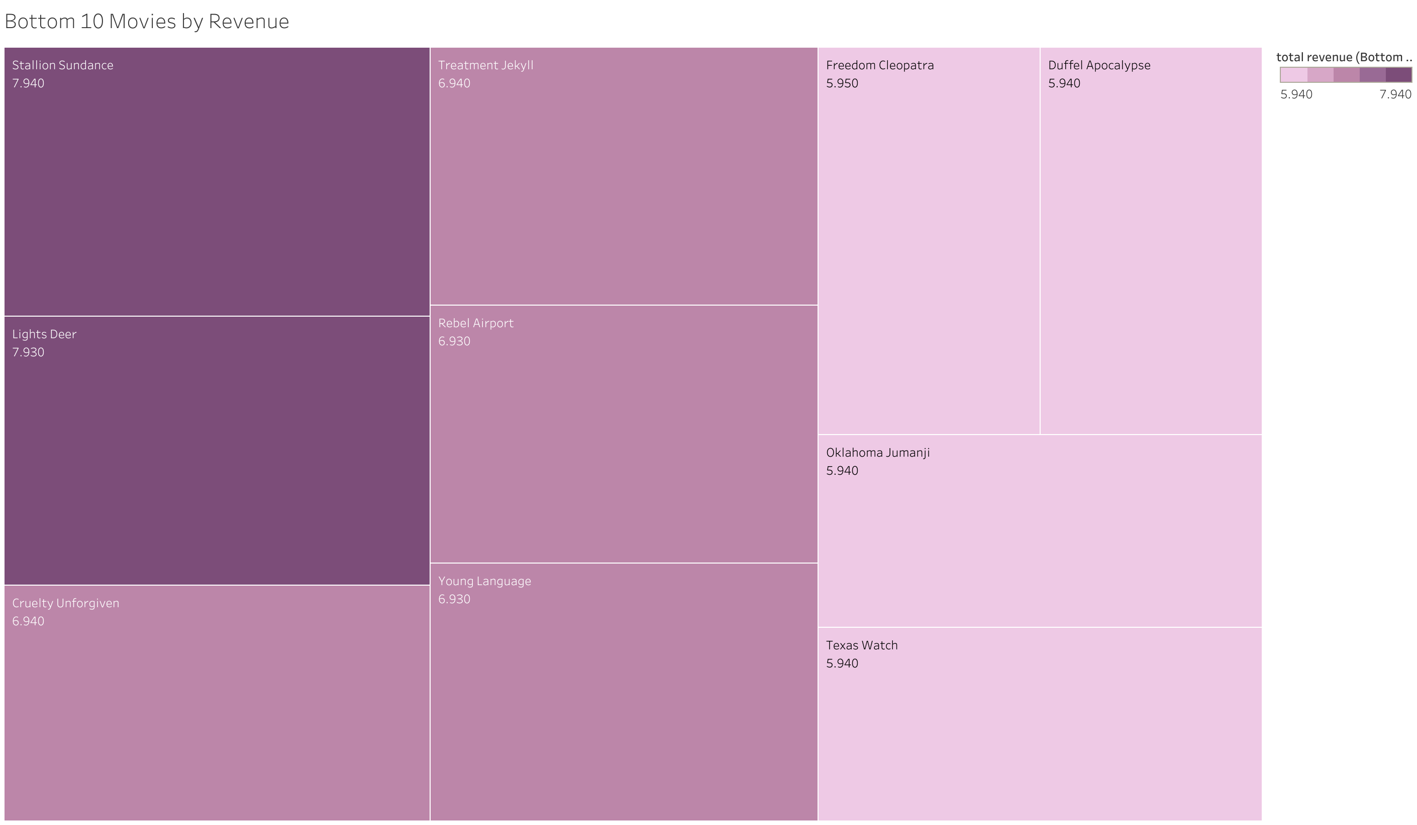
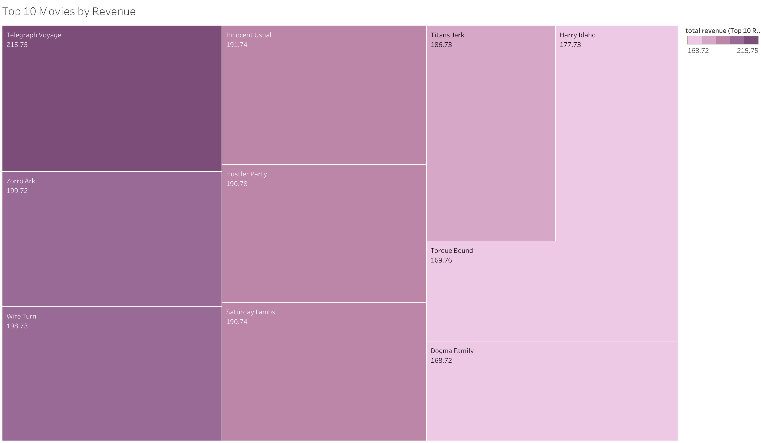
Movies by Revenue
Movies with least amount of revenue: Texas Watch, Oklahoma Jumanji, and Duffel Apocolypse
Movies with most revenue gain: Telegraphic Voyage, Zorro Ark, and Wife Turn
https://public.tableau.com/views/Bottom10MoviesbyTotalRevenue/Sheet2?:language=en-US&publish=yes&:display_count=n&:origin=viz_share_link
https://public.tableau.com/views/Top10MoviesbyTotalRevenue/Sheet2?:language=en-US&publish=yes&:display_count=n&:origin=viz_share_link

Slide 6
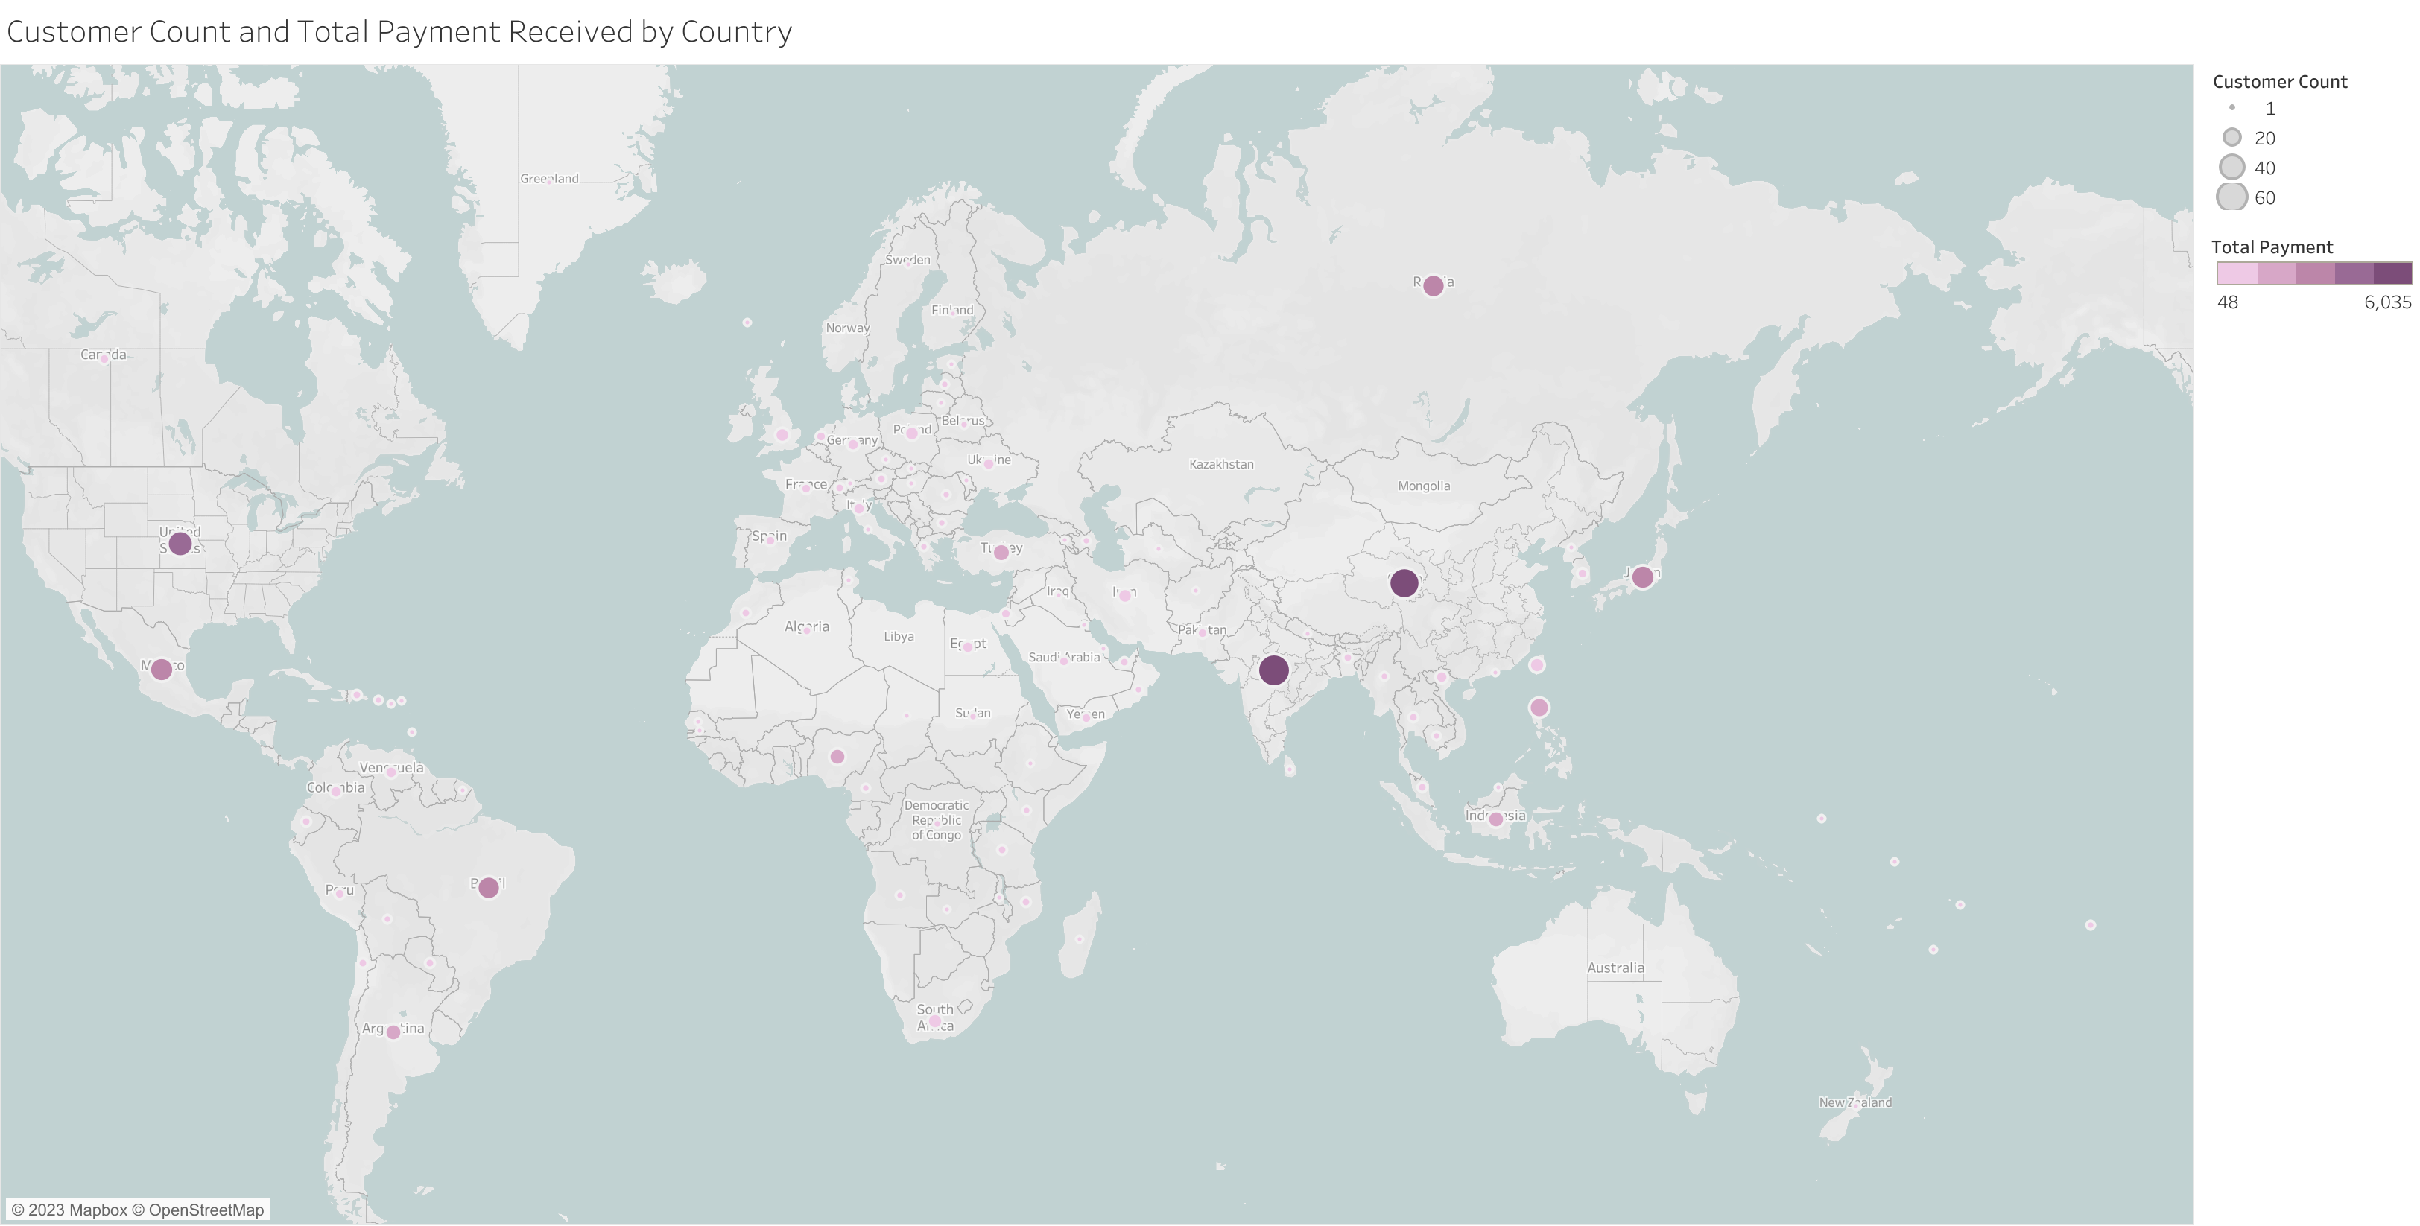
Countries with Rockbuster Customers
Rockbuster has customers worldwide but are most concentrated in:
India (60)
China (53)
United States (36)
Japan (31)
Mexico (30)
https://public.tableau.com/shared/C8JMPFRPY?:display_count=n&:origin=viz_share_link

Slide 7
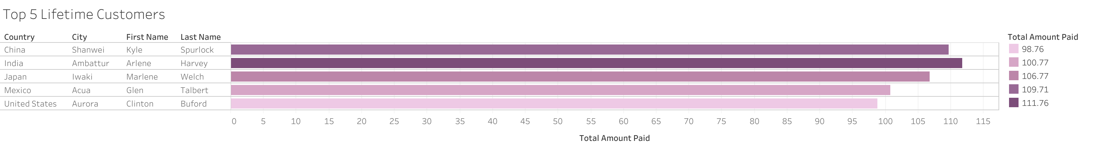
Top 5 Rockbuster Customers
Arlene Harvey – Ambattur, India
Kyle Spurlock – Shanwei, China
Marlene Welch – Iwaki, Japan
Glen Talbert – Acua, Mexico
Clinton Buford – Aurora, United States
https://public.tableau.com/views/Top5Customers_16838414115340/Sheet2?:language=en-US&publish=yes&:display_count=n&:origin=viz_share_link

Slide 8
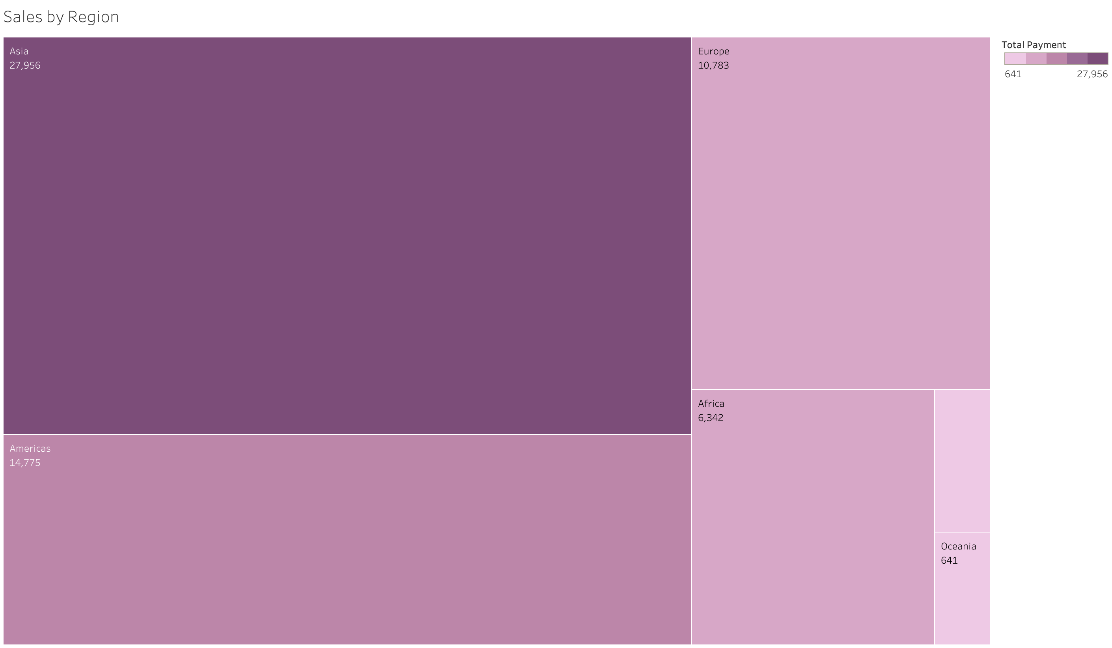
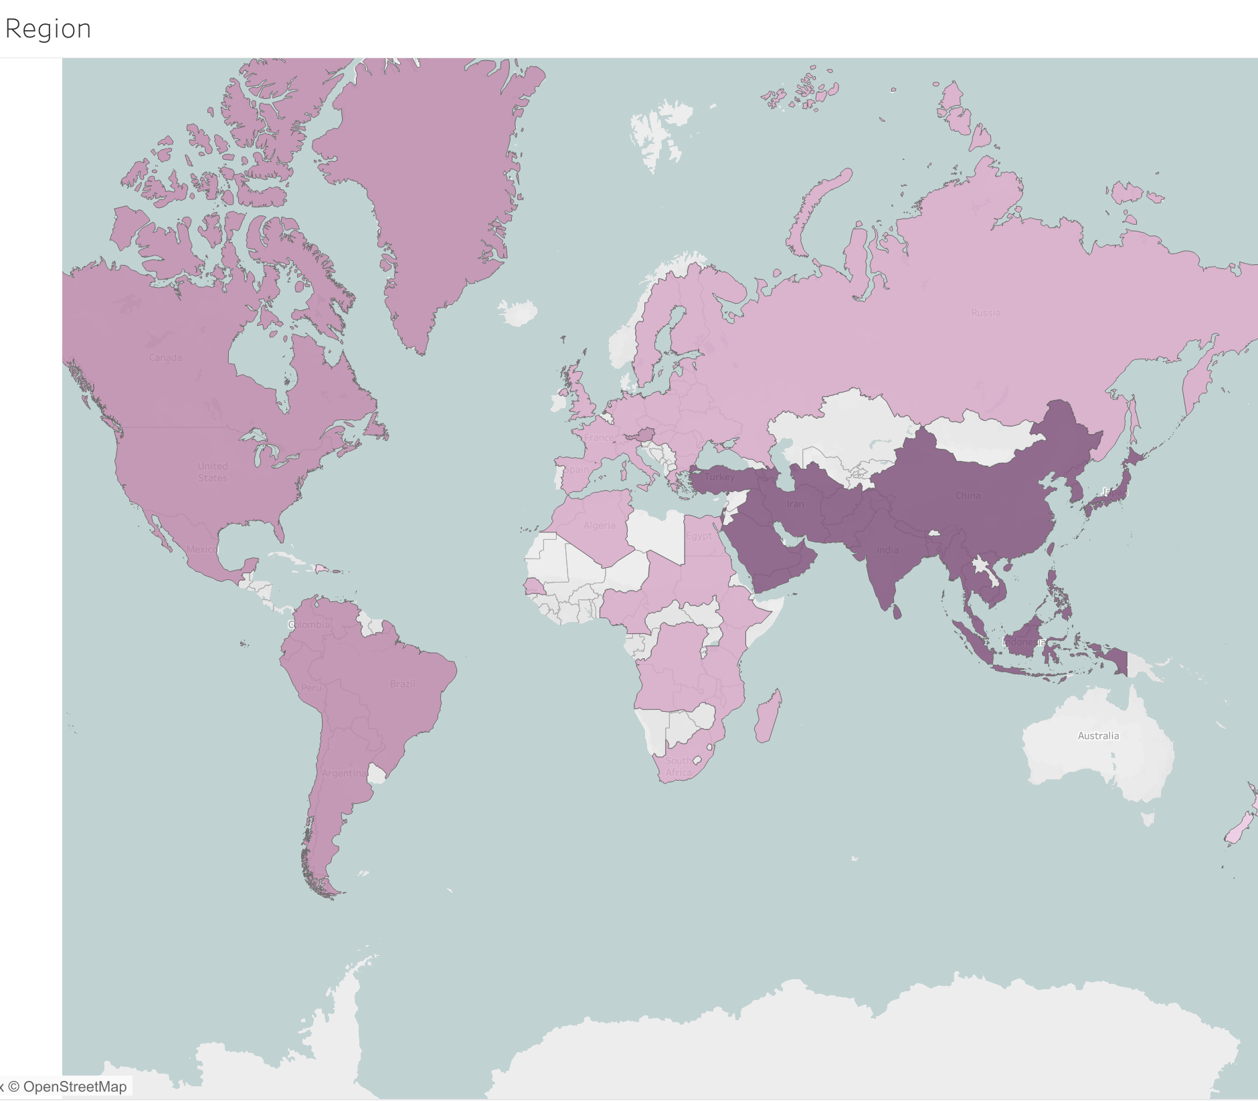
Regional Sales
Asia has collected the most payment out of any region
Followed by The Americas and then Europe
https://public.tableau.com/views/RegionalSales_16838527072620/Sheet1?:language=en-US&publish=yes&:display_count=n&:origin=viz_share_link
https://public.tableau.com/views/RegionalSalesTotals3_10/Sheet1?:language=en-US&publish=yes&:display_count=n&:origin=viz_share_link

Slide 9

Summary
Average rental duration: 4.985 days
Average rental rate: $ 2.98
Asia is the most popular region for Rockbuster
Countries with the most customers:
India, China, United States, Japan, and Mexico
Movies that made the most revenue:
Telegraphic Voyage, Zorro Ark, Wife Turn

Slide 10

Recommendations
Focus marketing efforts in Asia where the customer base is strongest.
Consider removing low revenue movies and prioritize movies with higher audience demands.
Implement loyalty programs to offer rewards for loyal and life-long customers.
Offer discounts or adjust rental prices for shorter rental durations to encourage customers to rent more often.

